Slide 1
1.1 Job Portal Web Overview
1.1.1. Overview and Goal
This Web App is used for JobSeeker / Employer who wants to find/post a job.
JobSeeker & Employer need to log-in before using the system.
1.1.2. Resolution:
User Storyboard:
JobSeeker login to the app to search/select a desired jobs.
JobSeeker can also view saved jobs, applied jobs, update profile.
Employer login to the app to post a job, or accept/reject an applicant.
Employer can also view saved jobs, posted jobs, update profile
Please see next slide for the layout

Slide 2
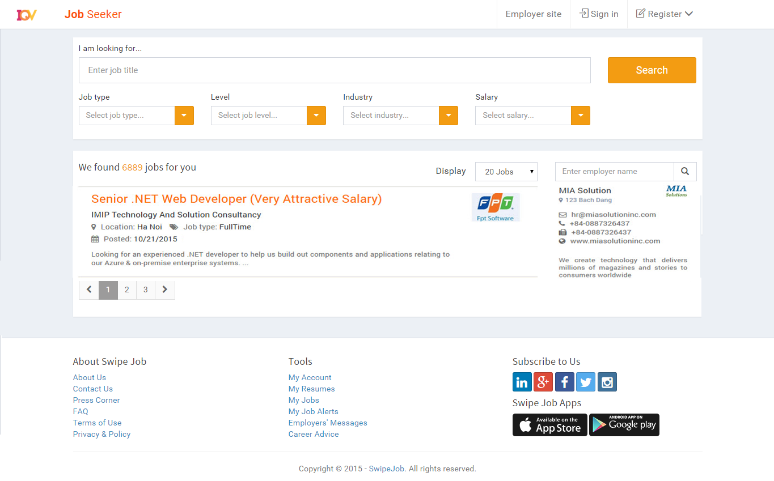
The page NOT logged in yet – for Guest

Slide 3
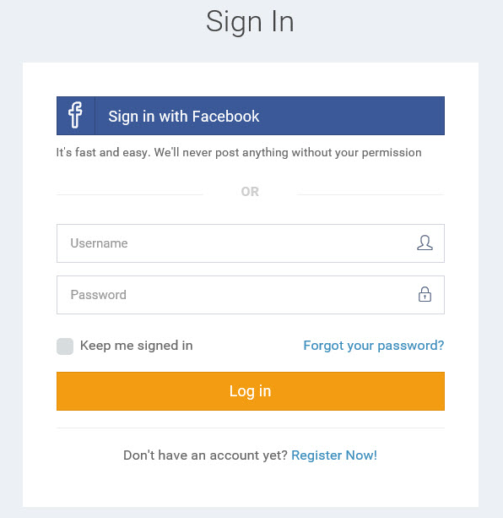
1.2. Login Page (JobSeeker)
1.1.1. Overview and Goal
• When selecting “Job Seeker” option from Home menu, the Login screen is displayed to require login or register an account.
• Fields: Email(username), Password
• Buttons: Login, Remember Me, Forgot password, Register
1.1.2. Resolution:
User Storyboard:
Click Login, system will check account is valid or not
Jobseeker can log in with Facebook option
Click “Forgot password” will show next screen to enter username(email) to be received an email for changing password
Select “Keep me signed in” to keep the loging
Click Register if user does not have an account.

Slide 4
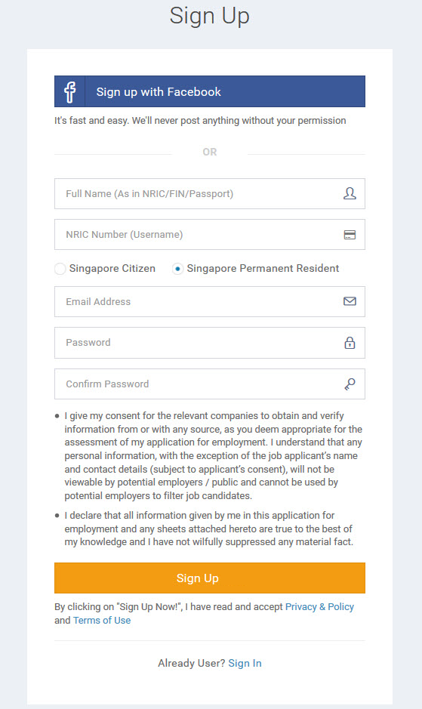
1.3. Register Page for JobSeeker
1.1.1. Overview and Goal
• Register screen for JobSeeker with all fields as design
• Buttons: Register
1.1.2. Resolution:
User Storyboard:
Guest click Sign Up to register an account
After submitting successfully, go to the registered email and click on an activation link to active account
Guest can also register with Facebook option

Slide 5
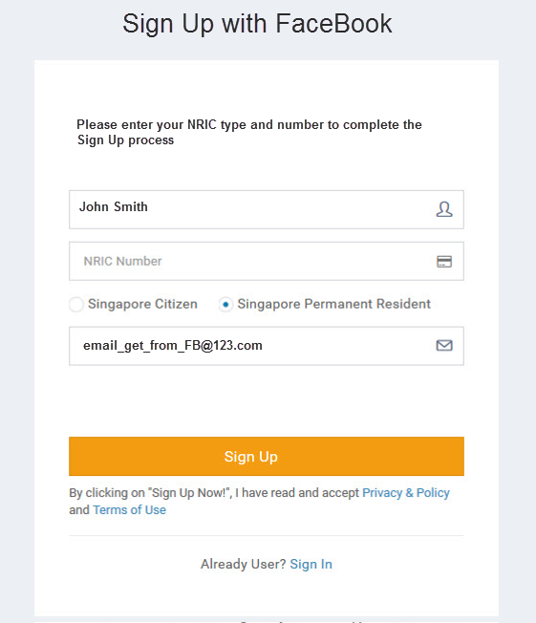
1.3.1 Last Step for sign up with FB
1.1.1. Overview and Goal
• After Jobseeker logged in the FB successfully, this screen will be displayed to enter NRIC type/number
• Fields: all fields should be as the design
• Buttons: Sign Up
1.1.2. Resolution:
User Storyboard:
Full name and Email will get from FB
Jobseeker needs to provide NRIC number/type
Then click Sign Up to complete and access the app

Slide 6
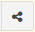
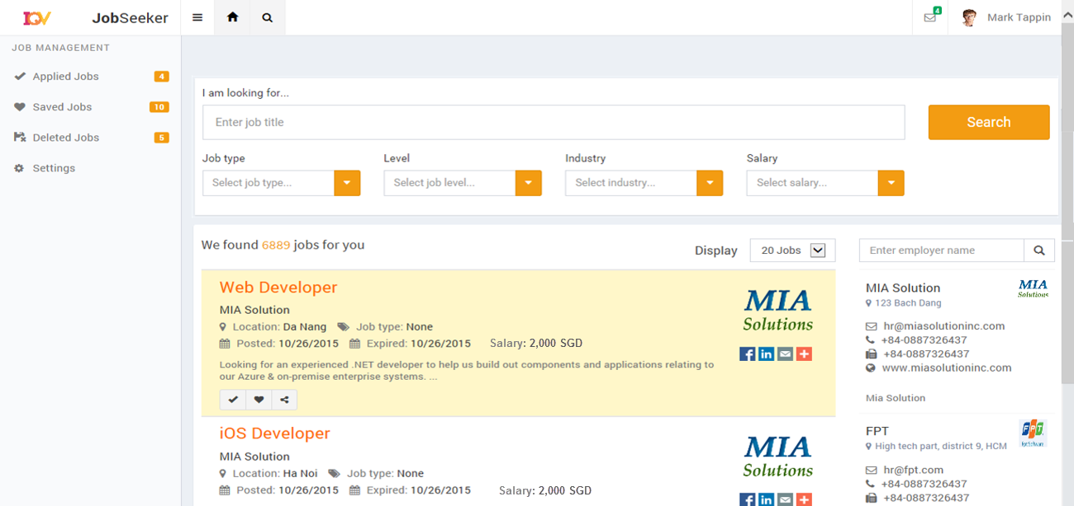
1.4. Home Page (JobSeeker – Logged in)
1.1.1. Overview and Goal
• This is Home page after a JobSeeker logged in successfully to the site
• All fields and info should be displayed as design
1.1.2. Resolution:
User Storyboard:
JobSeeker can Search jobs, Apply job , Save job or Share job
Click on a job to view more details

Slide 7
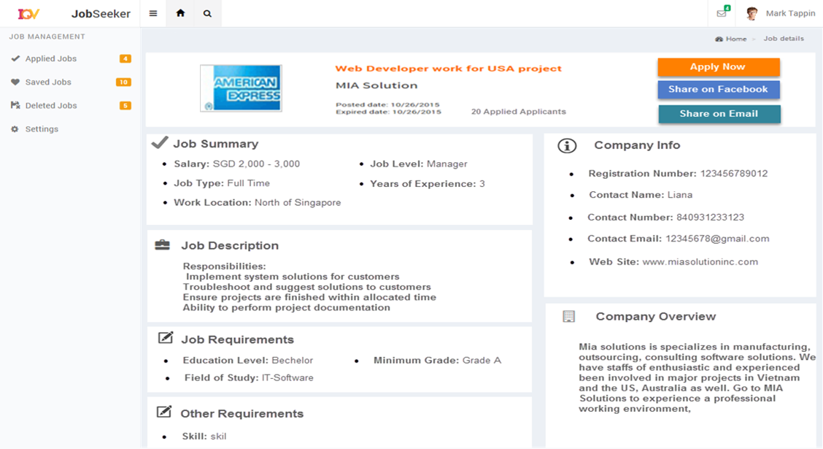
1.5. Job Details Page (JobSeeker)
1.1.2. Resolution:
User Storyboard:
Click Apply/ Save button to apply/ or save that job
Click “f” button to share via Facebook
Click “Email” button to share via email
1.1.1. Overview and Goal
• Job details screen will be displayed when JobSeeker clicks on a job to view in more details
• All fields and buttons as design

Slide 8
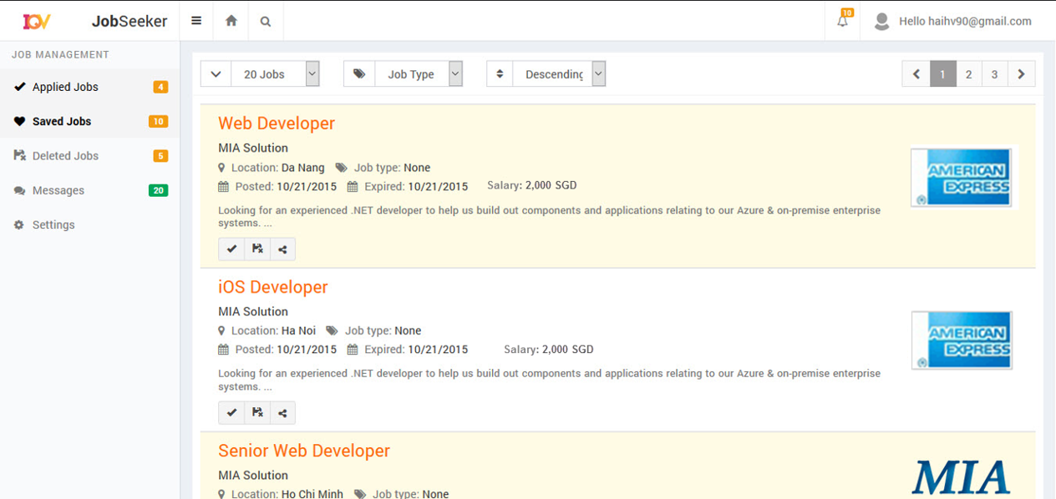
1.6. Saved Jobs Page (JobSeeker)
1.1.1. Overview and Goal
• This screen will be displayed when JobSeeker clicks on “Saved Jobs” from left menu.
• The screen shows all saved jobs- default sort on descending by posted date
1.1.2. Resolution:
User Storyboard:
Click if want to delete a job from saved list
Click if want to apply that job
Click if want to share job
Click on a job to view more details.

Slide 9
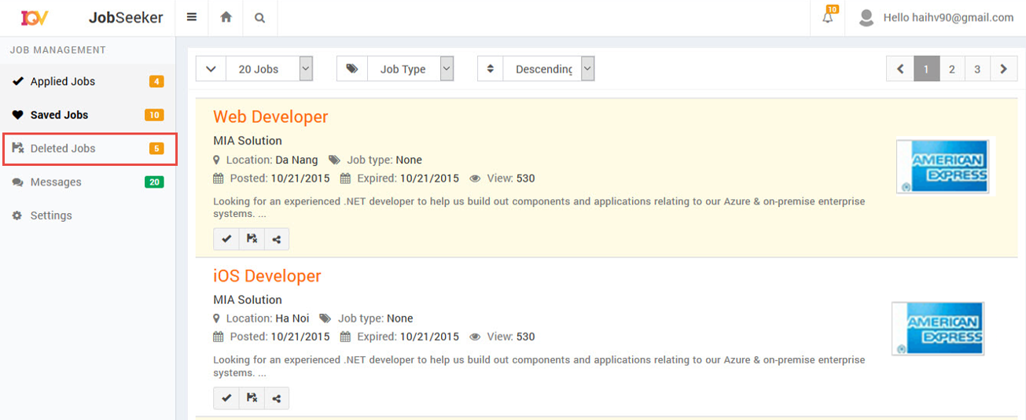
1.7. Deleted Jobs Page (JobSeeker)
1.1.1. Overview and Goal
• This screen will be displayed when JobSeeker clicks on “Deleted Jobs” from the menu. The screen shows all deleted jobs.
1.1.2. Resolution:
User Storyboard:
Click if want to remove a job from deleted list
Click if want to restore that job to saved list.
Click on a job to view more details.

Slide 10
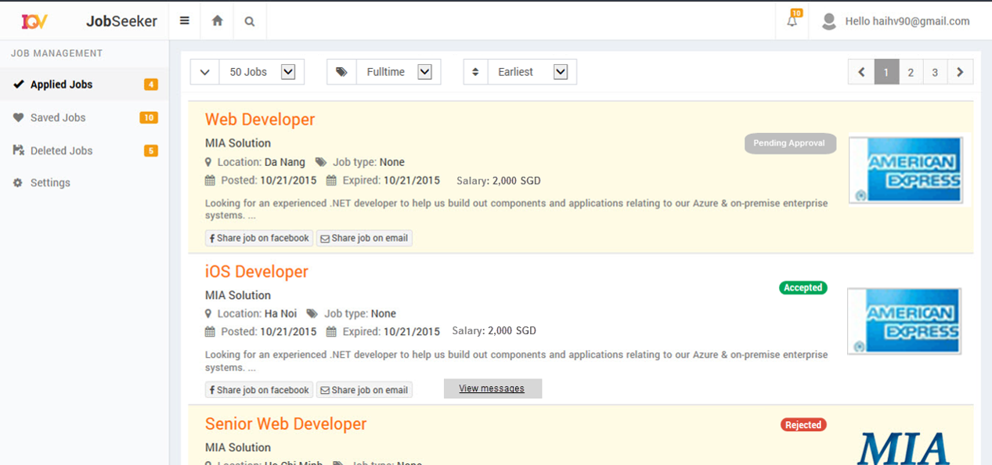
1.8. Applied Jobs Page (JobSeeker)
1.1.1. Overview and Goal
• This screen will show status of all applied jobs
• All job statuses in this screen are “Pending Approval”, “Accepted”, “Rejected”
• Default sort on Descending by Applied Date
1.1.2. Resolution:
User Storyboard:
JobSeeker access to “Applied Jobs” to view statuses of job (Pending Approval or Accepted or Rejected)
Click on a job to view more details or Share job
JobSeeker can click View Message to view message logs from employer (if any) for accepted job

Slide 11
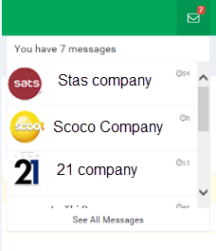
1.9. Jobs Messages (JobSeeker)
1.1.1. Overview and Goal
• From Home page JobSeeker can click on to open Message list
1.1.2. Resolution:
User Storyboard:
From the messages list, JobSeeker can click on a message to view in more details (message logs) or click “View All Messages” to show all messages screen

Slide 12
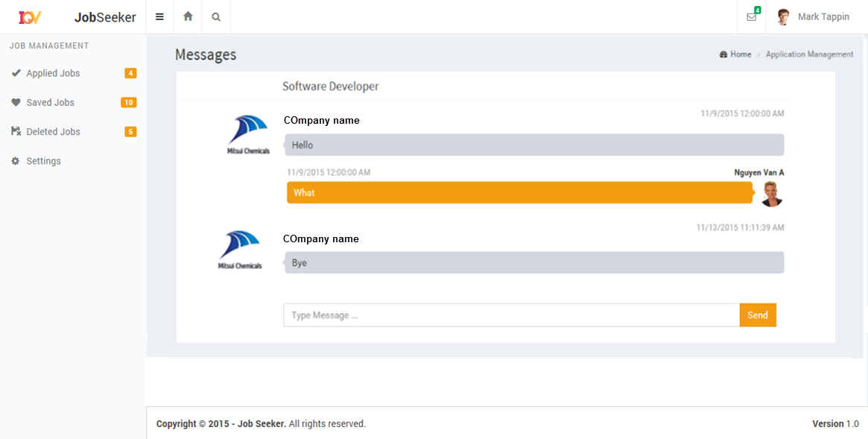
1.10. Message Logs (JobSeeker)
1.1.1. Overview and Goal
• The message log screen will be displayed when Jobseeker clicks on a new message from the message list in previous screen
1.1.2. Resolution:
User Storyboard:
In this screen, Jobseeker can enter new message to reply

Slide 13
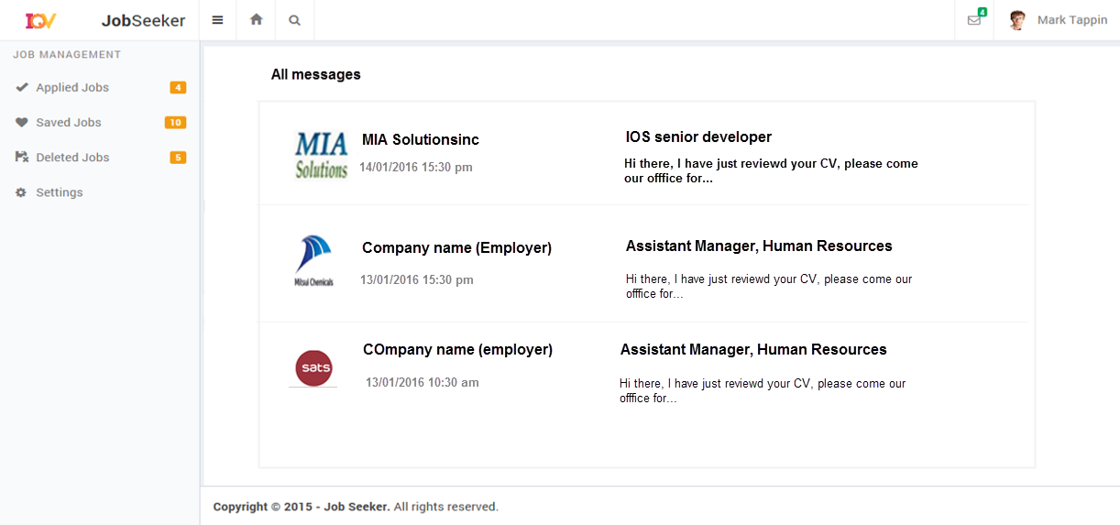
1.11. All Messages Page (JobSeeker)
1.1.1. Overview and Goal
• This screen displayed when Jobseeker clicks View All Message from messages list
1.1.2. Resolution:
User Storyboard:
In this screen, Jobseeker can click on a message to view in more details (message logs) – page 1.10 above

Slide 14
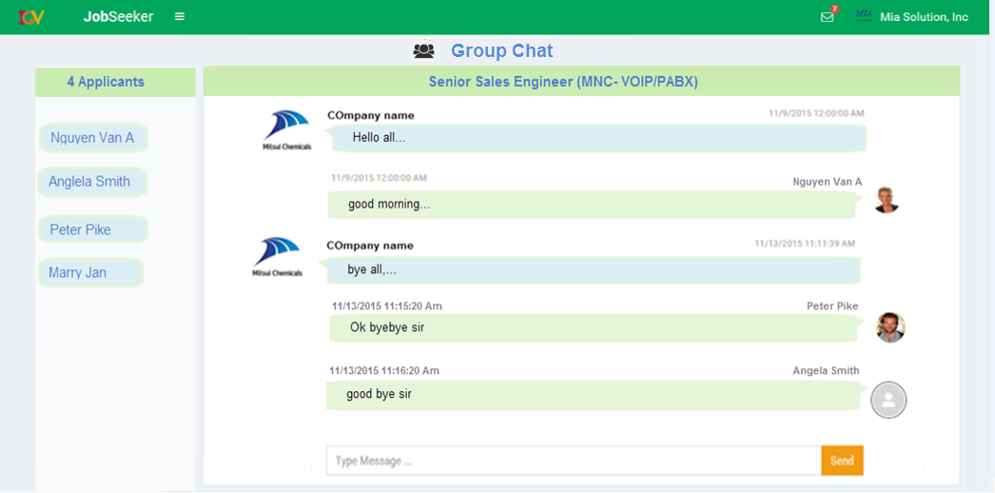
1.11.1. Job Seeker in Chat Group
1.1.1. Overview and Goal
• This screen displayed when Jobseeker clicks View All Message from messages list
1.1.2. Resolution:
User Storyboard:
In this screen, Jobseeker can click on a message to view in more details (message logs) – page 1.10 above

Slide 15
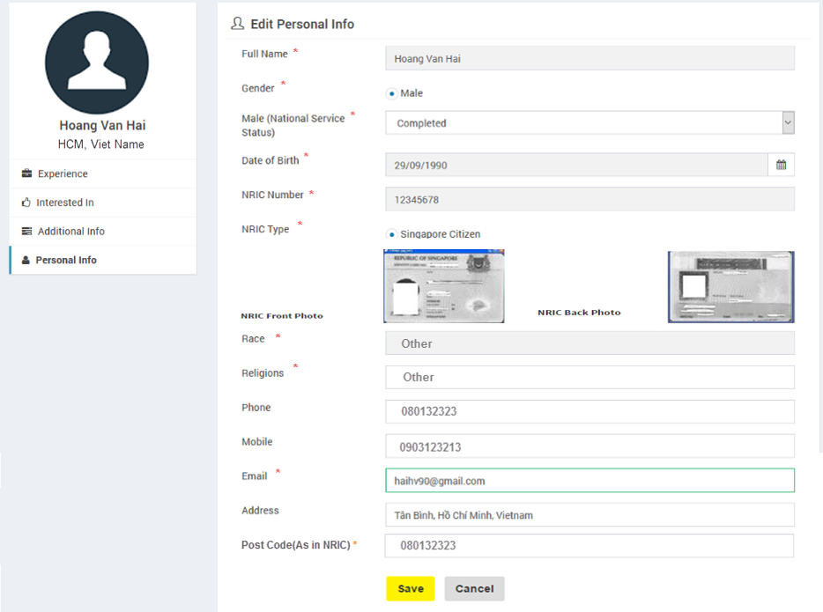
1.12. Profile Update - Personal Info (JobSeeker)
1.1.1. Overview and Goal
• This screen will be displayed when Jobseeker clicks on “Update Profile” option -> “Personal Info”
1.1.2. Resolution:
User Storyboard:

Slide 16
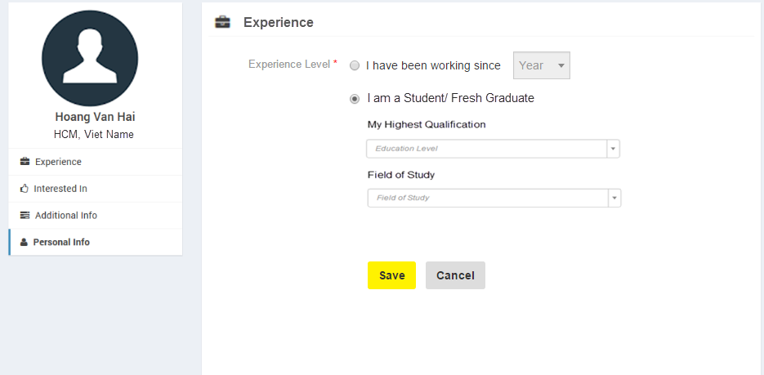
1.13. Profile Update - Experience (JobSeeker)
1.1.1. Overview and Goal
• This screen will be displayed when Jobseeker clicks on “Update Profile” option -> “Experience”
1.1.2. Resolution:
User Storyboard:

Slide 17
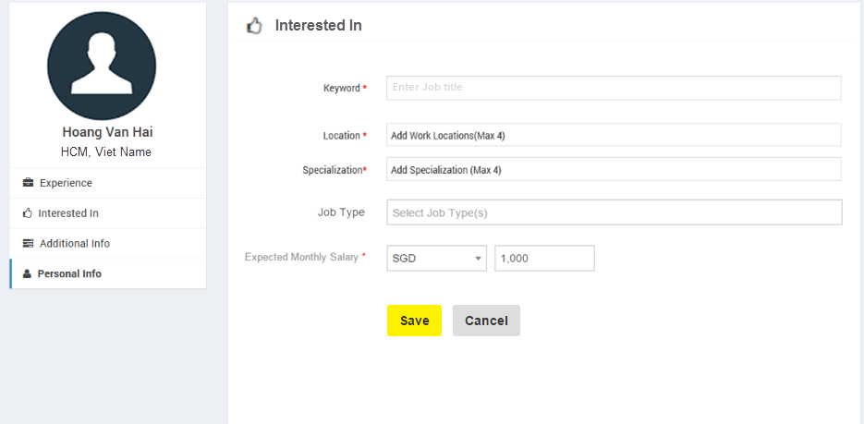
1.13.1. Profile Update - Interested In (JobSeeker)
1.1.1. Overview and Goal
• This screen will be displayed when Jobseeker clicks on “Update Profile” option -> “Interested In”
1.1.2. Resolution:
User Storyboard:

Slide 18
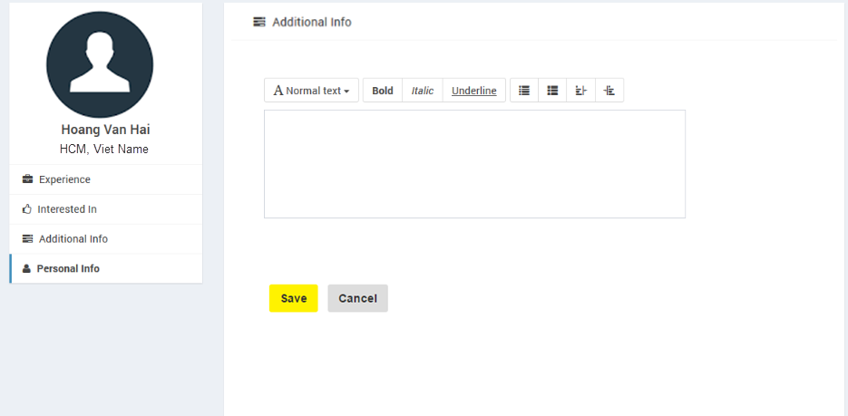
1.13.2. Profile Update – Additional Info(JobSeeker)
1.1.1. Overview and Goal
• This screen will be displayed when Jobseeker clicks on “Update Profile” option -> “Additional Info”
1.1.2. Resolution:
User Storyboard:

Slide 19
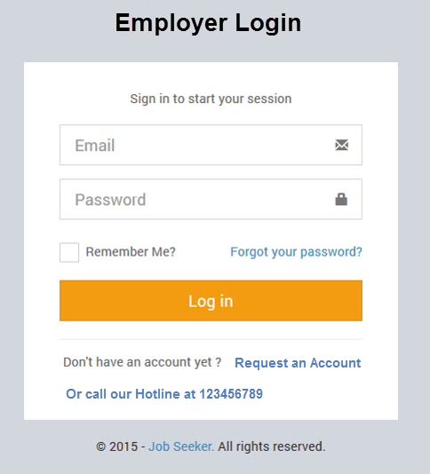
1.14. Login Page (Employer)
1.1.1. Overview and Goal
• When selecting “Employer” option from Home menu, the Login screen is displayed to require login or request an account.
• Fields: Email(username), Password
• Buttons: Login, Remember Me, Forgot password, Request an Account, “Call our hotline”
1.1.2. Resolution:
User Storyboard:
Click Login, system will check account is valid or not
Click “Forgot password” will show next screen to enter username(email) to be received an email for changing password
Select “Remember me” to keep the loging
Click “Request an account “ if user does not have an account.

Slide 20
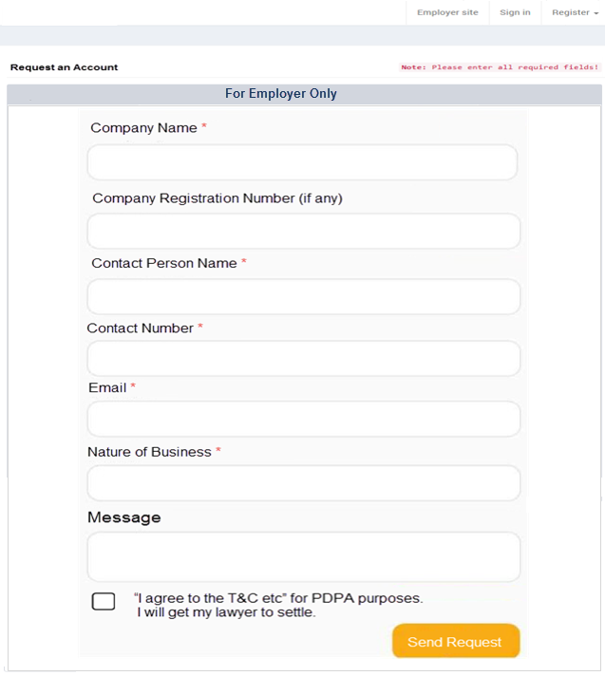
1.15. Request Employer Account Page
1.1.1. Overview and Goal
• Request an employer account screen with all fields as design
• Buttons: Send Request
1.1.2. Resolution:
User Storyboard:
After employer requested an account, admin will contact employer
How does employer get login account (user/password) after submitting an request?
- Resolution 1: Admin will create account's password and send via email to employer. Then employer can login by registered email and provided password. After logging he can change the password.
- Resolution 2: Admin will send employer a link so that employer can click on that link to open Create Account screen. In this screen he can create himself an username/password.
When clicking Send Request a next page displays to say “Your request has been submitted, you will be contacted by the next working day”

Slide 21
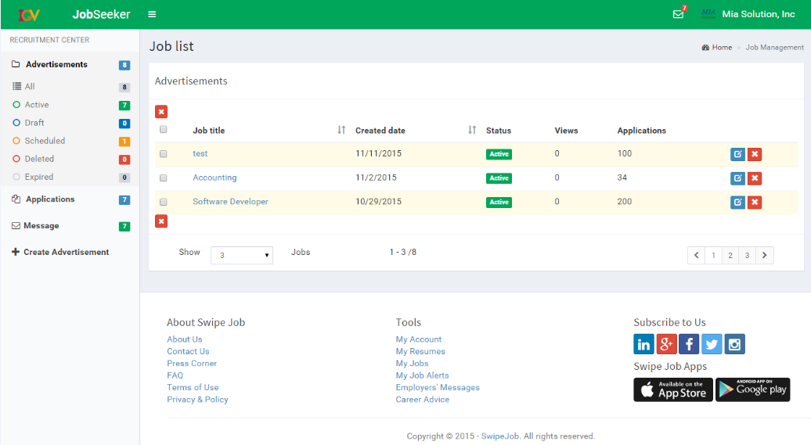
1.16. Home Page for Employer (after login)

Slide 22
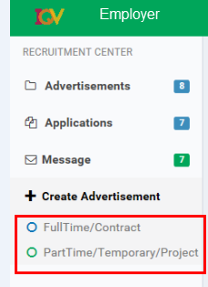
1.17. Create New Job (Employer)
1.1.1. Overview and Goal
• From Home page, Employer can select “Full Time/ Contact” or “Part time/Temporory/Project/ Internship”
1.1.2. Resolution:
User Storyboard:
When selecting an option, a Create Job page displays - please look at next slide
All below layouts is demo for “Full time/ Contract” type. For the other should similar the layout button some fields are different as requirement

Slide 23
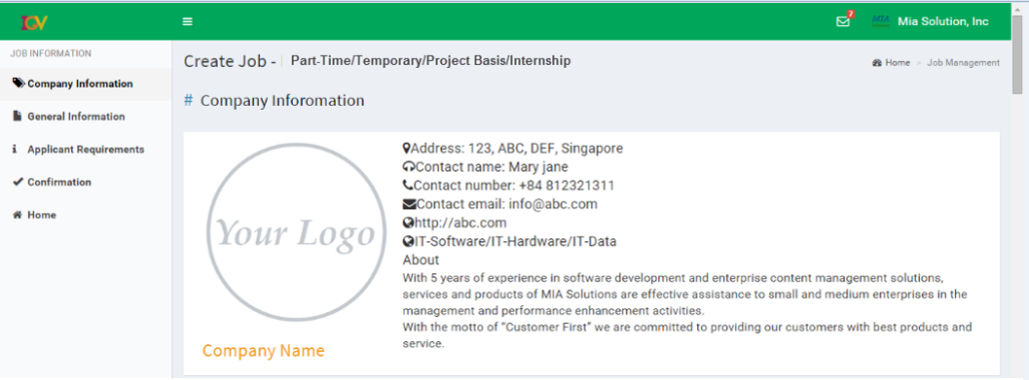
1.18. Create New Job – Company Info review

Slide 24
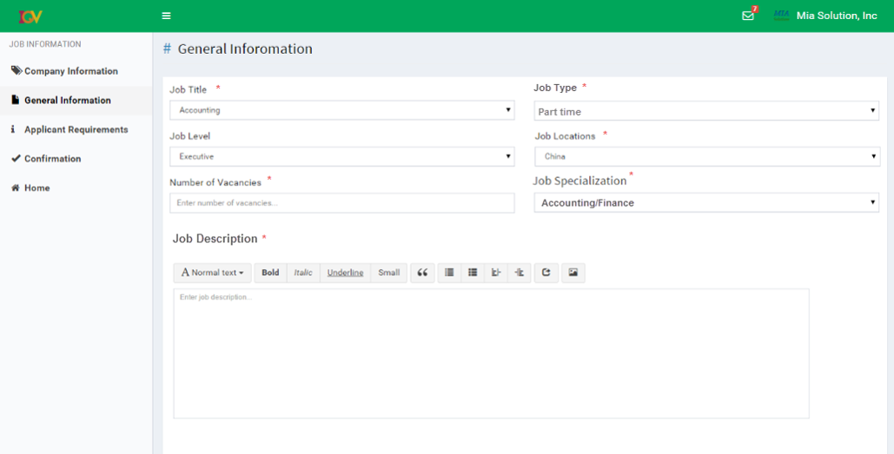
This mockup for “Part time” job. For “Full Time” will be similar to this
1.19. Create New Job – General Info

Slide 25
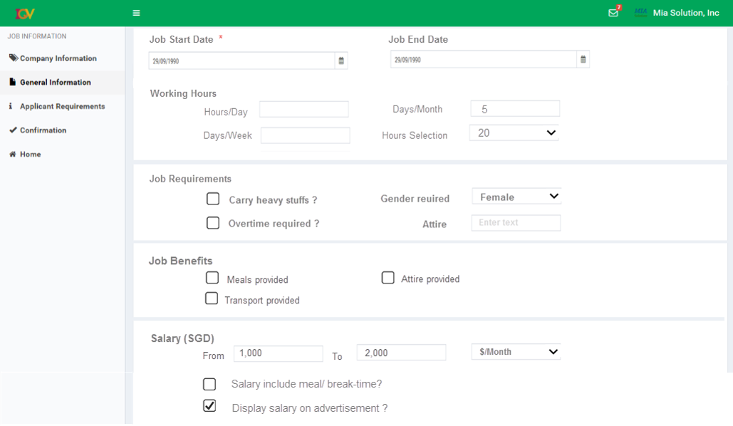
Question 1: can employer enter all of [Hours/Day, Days/Week, Days/Month, Hours Selection]; or he can only enter one of them ?
1.20. Create New JOb – General Info (Next page)
Question 2: “Hours Selection” should be a dropdown list as mockup or a Range of Hours, example “09:30 AM to 13:30 PM“ ?

Slide 26
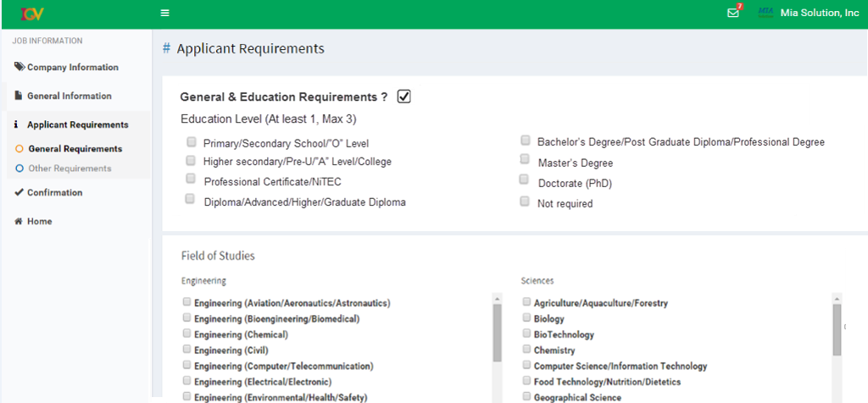
1.23. Create New Job – Applicant Requirements

Slide 27
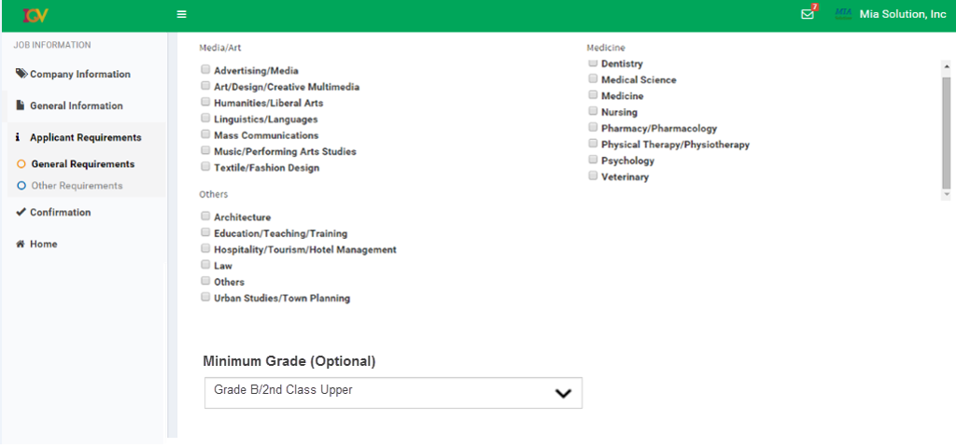
1.24. Create New Job – Applicant Requirement (Next Page)

Slide 28
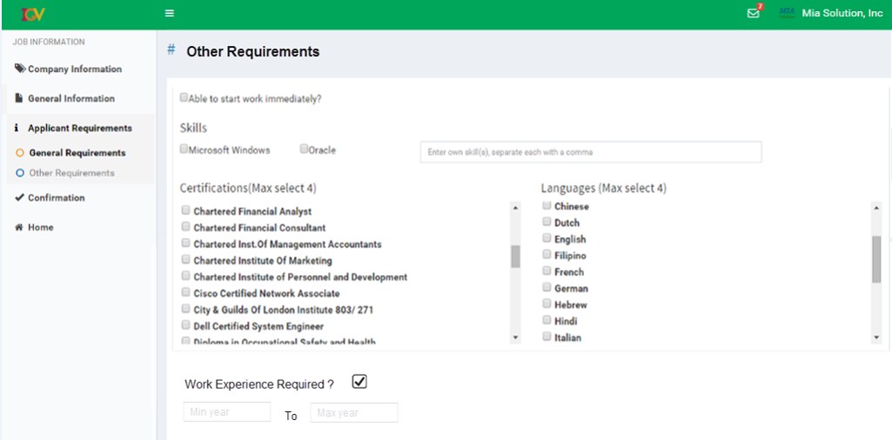
1.25. Create New Job – Other Requirements

Slide 29
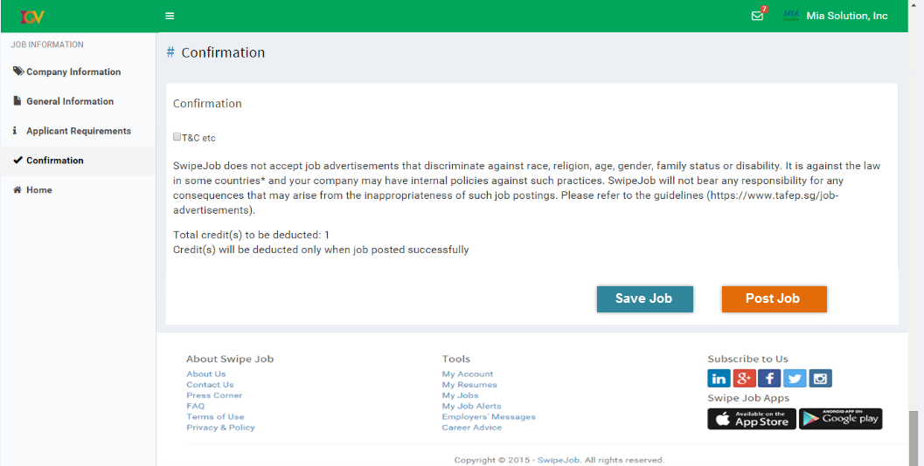
1.26. Create New Job – Confirmation page

Slide 30
How does an active job get status of "Expired Job" ?
- Resoluton 1: when posting a job, employer can select an option to expire the job, example, job expired after "1 month" , "2 months"…and so on
- Resolution2: Admin will set the period for each employer, example
+ Employer 1 has period of 1 month for posting job
+ Employer 2 has period of 2 months for posting job
--> then the posted job will be expired when the period of employer is reached
1.27. My Jobs Page (Employer)
1.1.1. Overview and Goal
• All statuses of my job are “Active”, “Draft”, “ Scheduled”, “Deleted”, “Expired”
1.1.2. Resolution:
User Storyboard:
From this page, Employer can go each job status page
Employer can modify post job but can NOT edit Job Title

Slide 31
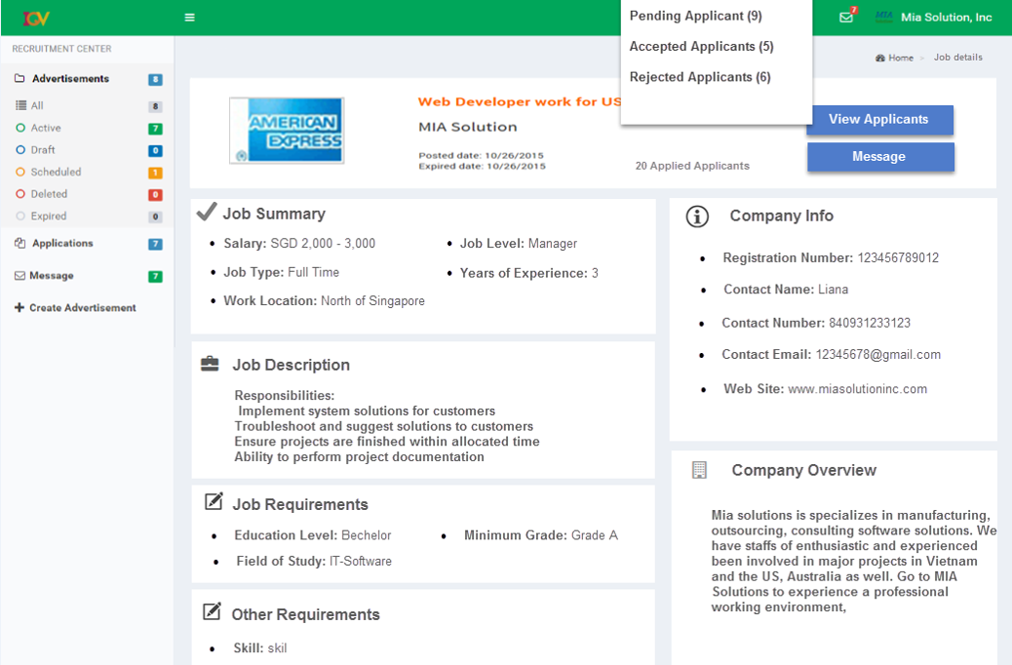
1.27.1. Active Job Details page(Employer)
1.1.1. Overview and Goal
• This page displayed when clicking on an Active job in previous page
1.1.2. Resolution:
User Storyboard:
In this page, Employer can select to view “appending/accepted/rejected applicants”. Employer can also to message to them.

Slide 32
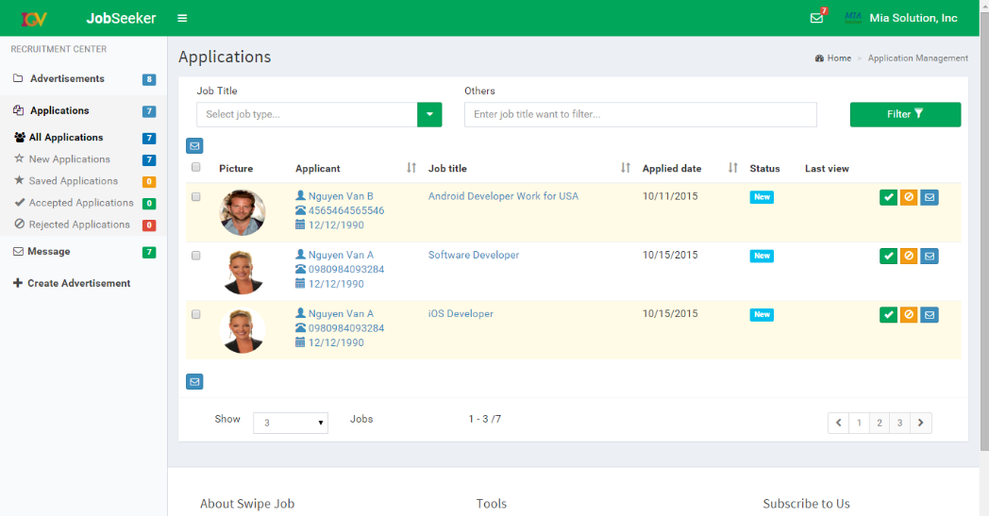
1.28. Applicant Listings (Employer)
1.1.2. Resolution:
User Storyboard:
• Employer can Save, Accept, Reject or Message to an applicant
1.1.1. Overview and Goal
• This screen will show all applicants for the selected Job.
• This screen displayed when clicking on Pending Applicants option from Job Details - page 1.27.1

Slide 33
1.29. Applicant Details Page (Employer)
1.1.1. Overview and Goal
• This screen will be displayed when employer click on an applicant from the list to view in more details
• In this screen employer can accept/reject, save or message to an applicant
1.1.2. Resolution:
User Storyboard:
Click “Accept” button to accept that applicant
Click “Reject” button to reject that applicant
Click “Save” button to accept that applicant
Click “Message” button to send a message to that applicant
Please go to next slide for the layout

Slide 34
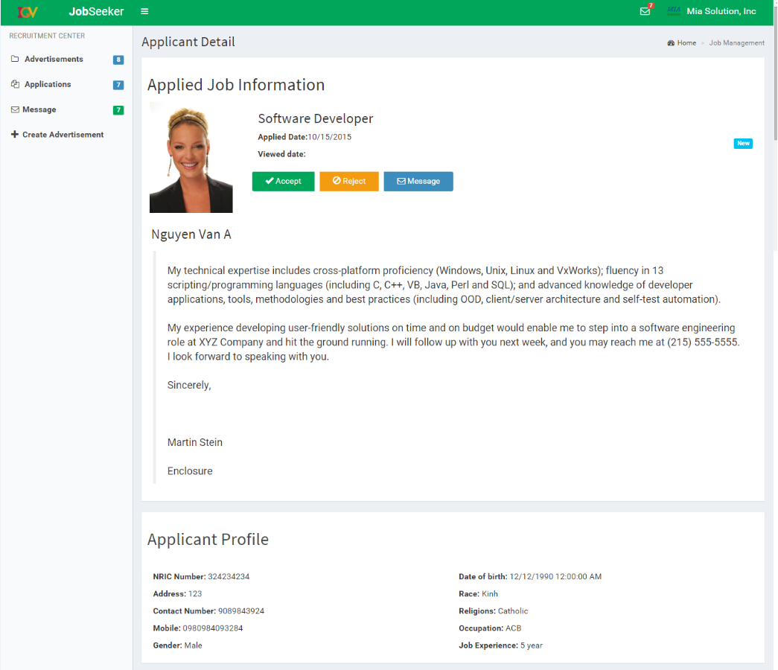
See next page

Slide 35
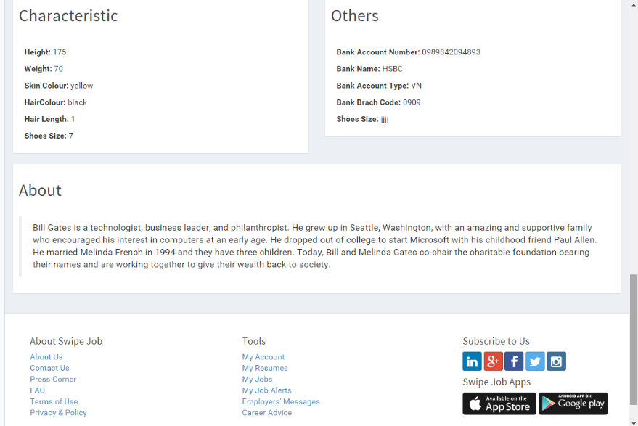

Slide 36
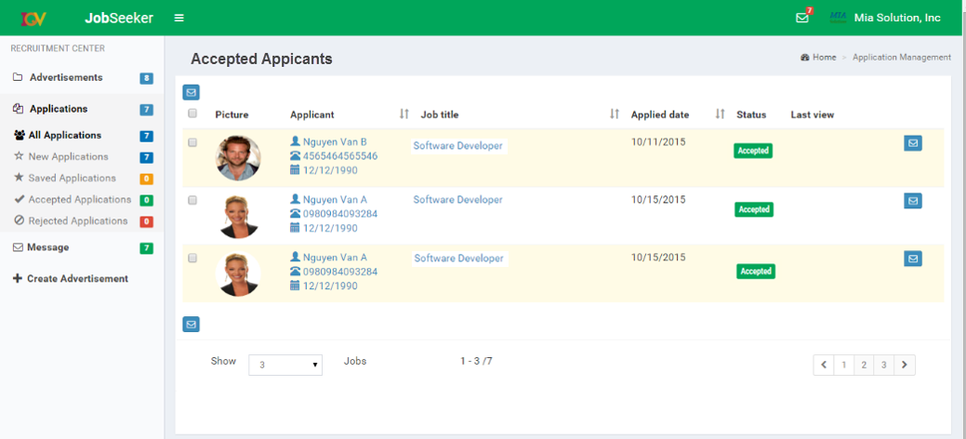
1.30. Accepted Applicants Page (Employer)
1.1.1. Overview and Goal
• This screen will be displayed when employer clicks on Accepted Applicants option from Job Details - page 1.27.1
1.1.2. Resolution:
User Storyboard:
Click Message iocn to send a message to that applicant
Select multi- applicants and click Message icon to send a group of selected applicants

Slide 37
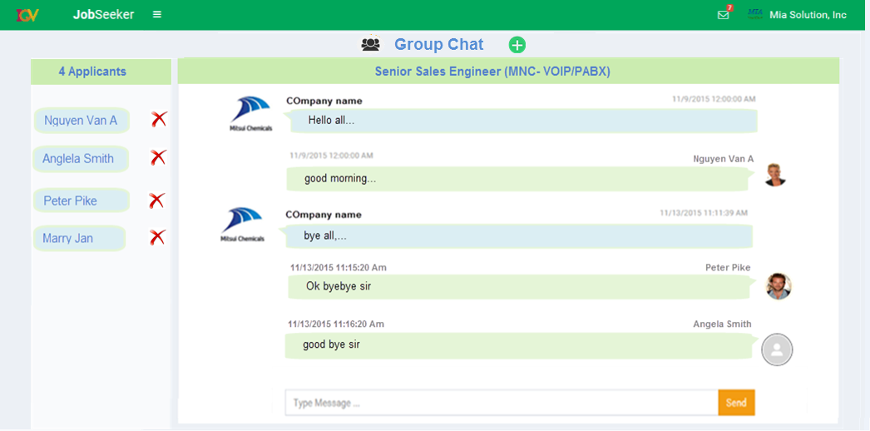
1.30.1. Chat Group Page (Employer)
1.1.1. Overview and Goal
• This screen will be displayed when employer clicks on Accepted Applicants option from menu
1.1.2. Resolution:
User Storyboard:
Click Message iocn to send a message to that applicant
Select multi- applicants and click Message icon to send a group of selected applicants

Slide 38
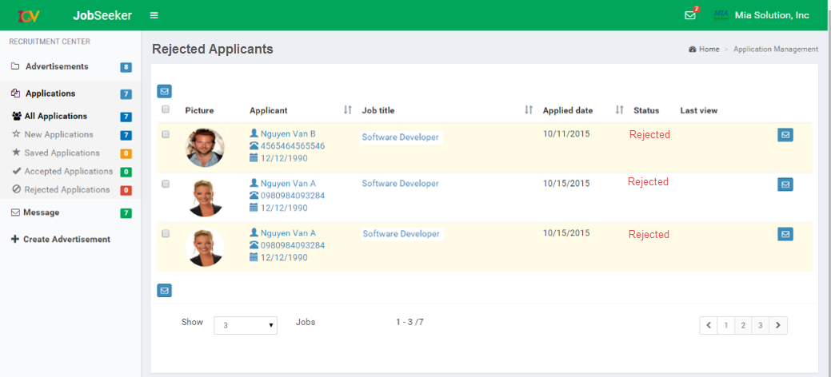
1.30.2. Rejected Applicants Page (Employer)
1.1.1. Overview and Goal
• This screen will be displayed when employer clicks on Rejected Applicants option from Job Details – page 1.27.1
1.1.2. Resolution:
User Storyboard:
Click Message icon to send a message to that applicant
Select multi- applicants and click Message icon to send a group of selected applicants

Slide 39
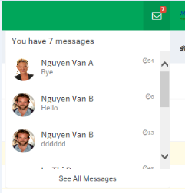
1.31. Message Notification (Employer)
1.1.1. Overview and Goal
• This message list will be displayed when employer click on “Message” icon
from the taskbar
1.1.2. Resolution:
User Storyboard:
In this list, employer can each applicant to view new message; or click “View all Messages” to open Message Board (as next slide)

Slide 40
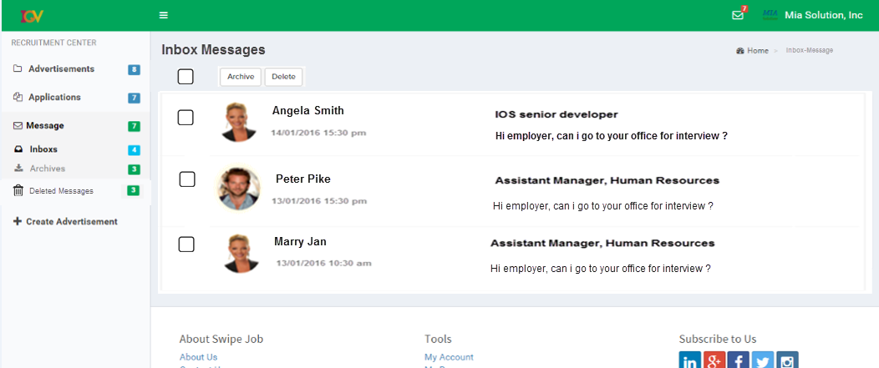
1.32. Inbox-Message board (Employer)
1.1.1. Overview and Goal
• This page will be displayed when employer click on “Message/Inbox” option from the menu
1.1.2. Resolution:
User Storyboard:
In this screen, Employer can Replay, Archive, Delete a message

Slide 41
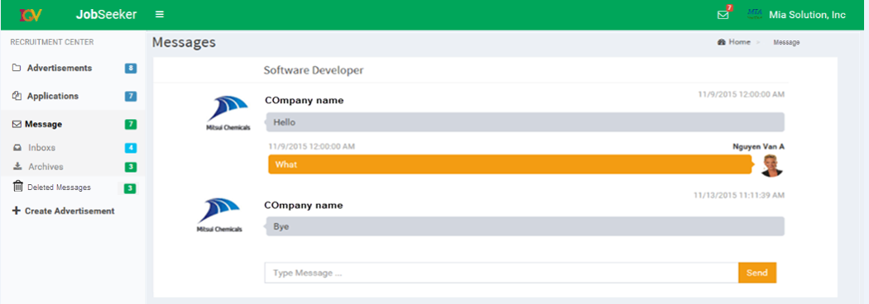
1.33. Inbox-Message Details (Employer)
1.1.1. Overview and Goal
• This page will be displayed when employer click on a message to view in more details
1.1.2. Resolution:
User Storyboard:
The details will display all histories of message that sent between the JobSeeker and Employer for a job

Slide 42
1.34. Profile Page (Employer)
1.1.1. Overview and Goal
• This screen will be displayed when employer clicks on Edit Profile menu
1.1.2. Resolution:
User Storyboard:
Employer can update the profile
Employer click Save Changes to save
Employer click Cancel to close the form without saving
Please go to next slide for the layout

Slide 43
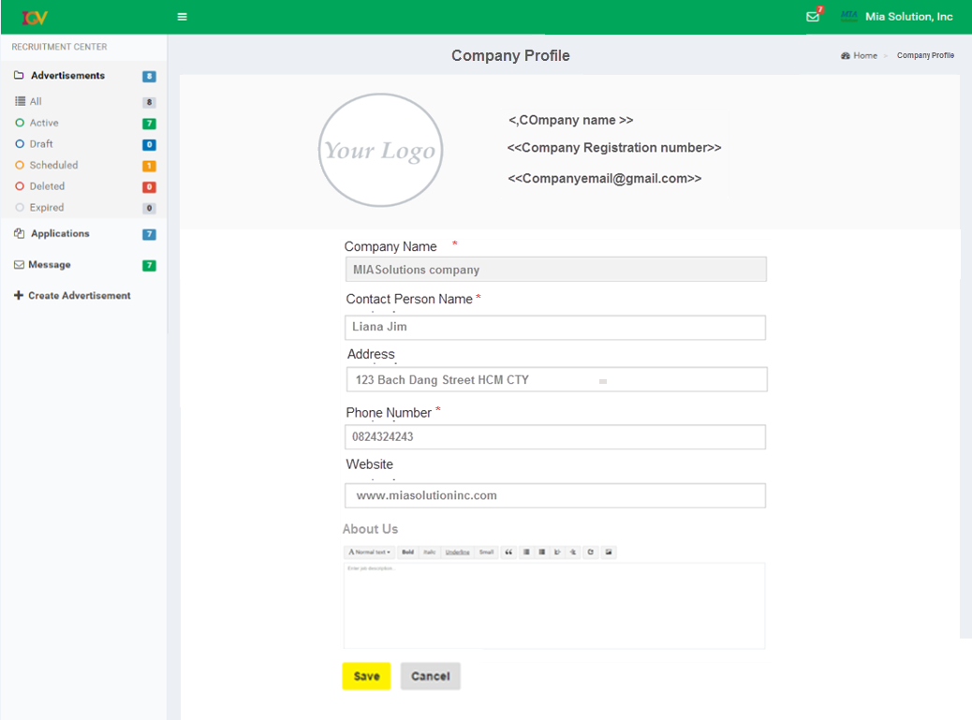
The “Company Name” field can not be modified (should disable it)

Slide 44
1.35. Administrator Page
1.1.1. Overview and Goal
This page is used for Administrator who can access to the system to active / inactive registered account for employers, reject/approve a posted job of an employer, monitor and follow up the interaction between jobseeker and employer
1.1.2. Resolution:
User Storyboard:
Admin clicks “Employers” menu to view all employer in the system
Clicks “Job Seekers” menu to view all Job Seekers in the system
Clicks “Posted Jobs” to view all posted jobs of all employers
Clicks “Job Status” to view the interaction between jobseeker and employer

Slide 45
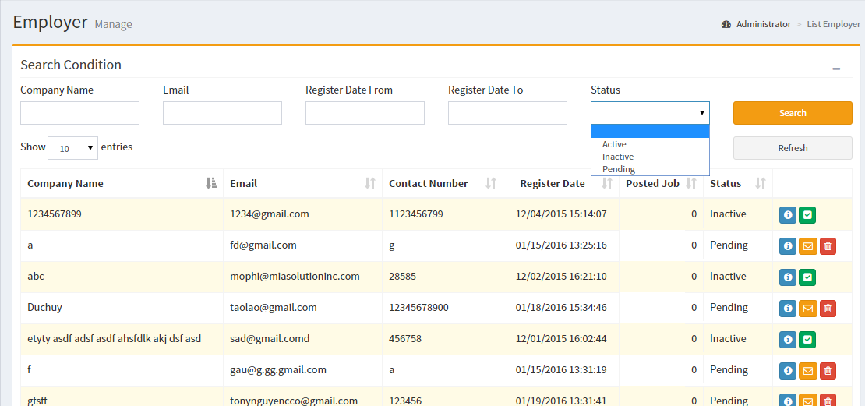
1.36. Review Requested Employer Accounts Page
1.1.1. Overview and Goal
• This screen is used for Admin to active/inactive a registered employer account
• All fields should be looked as design
1.1.2. Resolution:
User Storyboard:
Admin clicks to view more info of employer
Admin clicks to active employer account
Admin clicks to In-active account (for an active account)

Slide 46
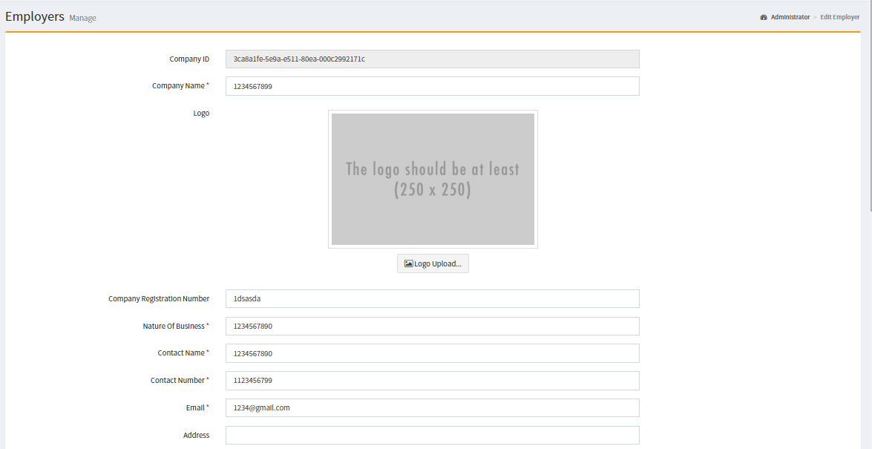
1.37. View & Edit Employer Details Page - Admin
1.1.2. Resolution:
User Storyboard:
Admin can Active a Pending /In-active account
Admin can In-active an Active account
1.1.1. Overview and Goal
• This screen will be displayed when Admin clicks on View More Details of an employer

Slide 47
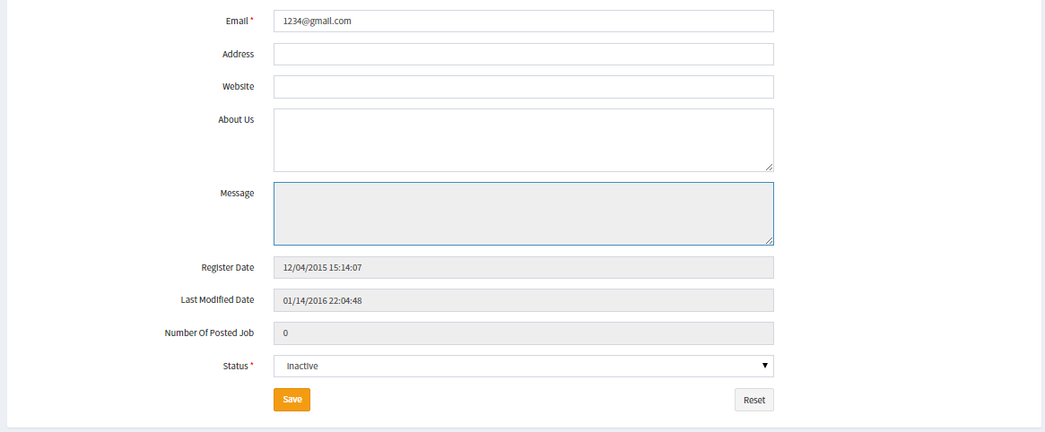
1.37.1 View & Edit Employer Details Page Cont…
1.1.1. Overview and Goal
• This screen will be displayed when Admin clicks on View More Details of an employer
1.1.2. Resolution:
User Storyboard:
Admin can Active a Pending /In-active account
Admin can In-active an Active account

Slide 48
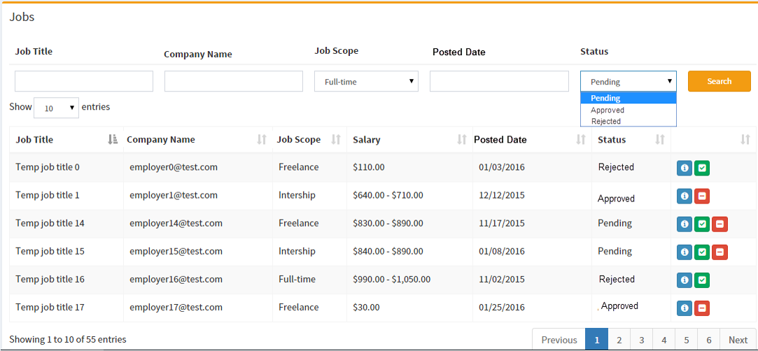
1.38. Review Posted Jobs Page - Admin
1.1.1. Overview and Goal
• This screen is used for Admin to view and approve or reject a posted job of all employers
• All fields should be looked as design
1.1.2. Resolution:
User Storyboard:
Admin clicks to view more details of job
Admin clicks to approve a job
Admin clicks to reject a job with a “Reject Note”

Slide 49
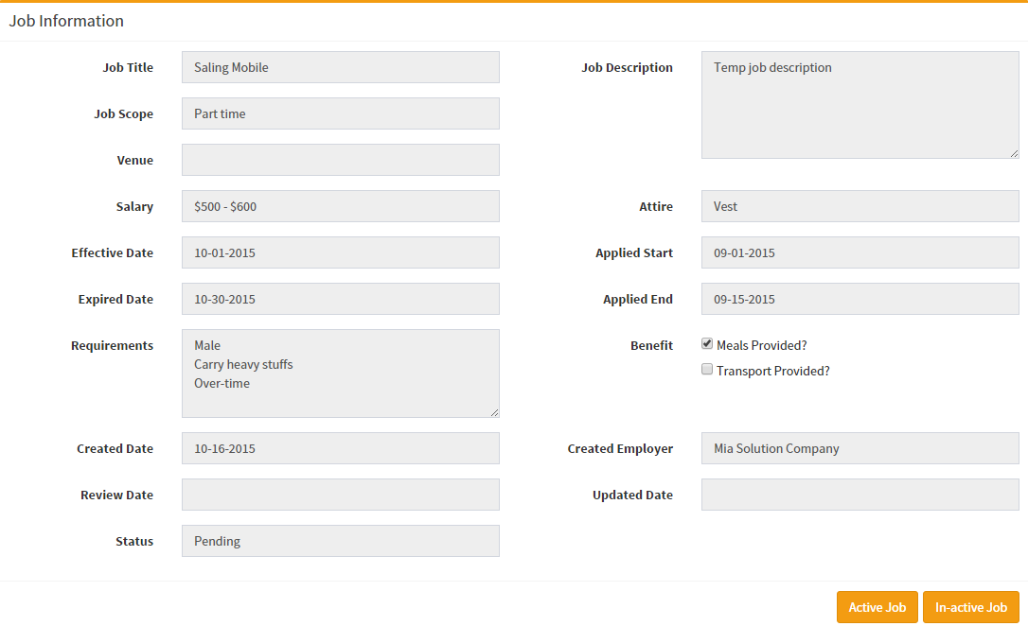
1.39. View Job Details Page - Admin
1.1.1. Overview and Goal
• This screen will be displayed when Admin clicks on View Details of a job
• All fields should be looked as design
1.1.2. Resolution:
User Storyboard:
In this screen, Admin can also Active or in-Active a job
Admin can also modify a job by clicking Edit button
When Admin clicks “Edit” button -> all fields should be enabled to modify

Slide 50
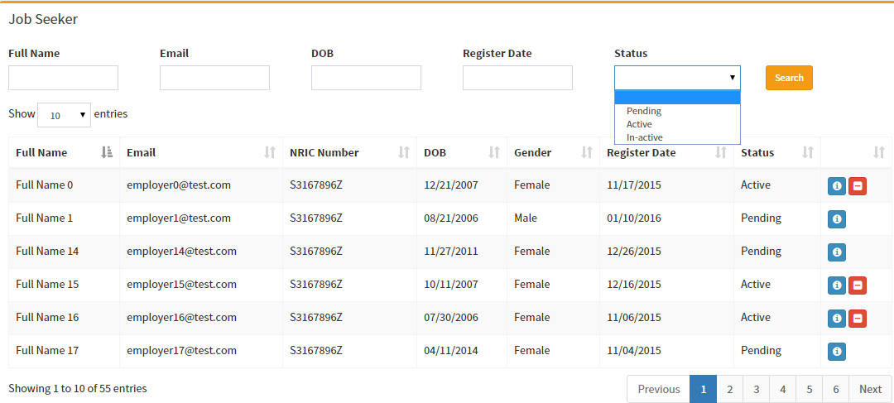
1.40. View JobSeeker Profiles Page - Admin
1.1.1. Overview and Goal
• This screen is used for Admin to view and can disable an account of Job Seeker
• All fields should be looked as design
1.1.2. Resolution:
User Storyboard:
Admin clicks to view more info of JobSeeker
Admin clicks to disable JobSeeker account
Admin clicks to enable a disabled account of JobSeeker

Slide 51
1.41. View JobSeeker More Details Page - Admin
1.1.1. Overview and Goal
• This screen is used for Admin to view and can also disable an account of Job Seeker
• All fields should be looked as design
1.1.2. Resolution:
User Storyboard:
Admin clicks “In-active” button if wants to disable that Jobseeker
Admin can Edit a JobSeeker by clicking Edit button
Please go to next slide for the layout

Slide 52
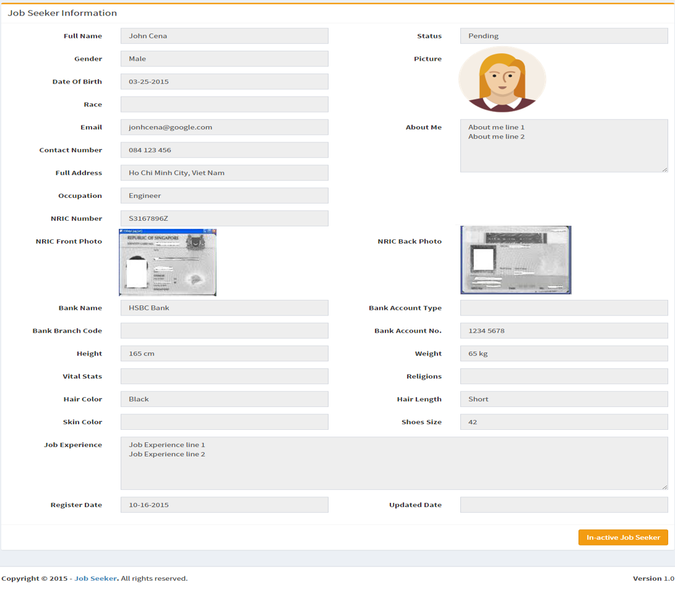
When Admin clicks “Edit” button -> all fields should be enabled to modify

